Slide 1
A Design of One-Time Password Mechanism using Public Key Infrastructure
By Hyun-Chul Kim, Hong-Woo Lee, Kyung-Seok Lee, Moon-Seog Jun
Abdullah Sheneamer
CS691
Dr.Edward Chow

Slide 2
Outline
Introduction
S/Key Authentication Mechanism
Challenge-Response based Authentication Mechanism
Authentication Mechanism using Time
The proposed System
Comparison and Analysis
Conclusion

Slide 3
Introduction
User authentication methods:
-Based on What user knows
- Based on the object user owns
- Based on the information existing in user’s
body
-Based on user’s behavioral information
Notes:
* such as password and PIN (Personal Identification Number). The problem that conjecture is easy and safety for password transferred is not guaranteed due to various crack tools.
* Such as smart card and token. This method provides strong authentication compared to password authentication but has the problem of loss or theft
* Like fingerprint, this stronger than the previous two methods.
Such as signature and voice. This method solves offensive feeling problem of authentication that can occur to users. However, Signature is not widely used culturally and signature consistency is often not maintained.
* One-time password mechanism solves password problems like password conjecture and wiretapping that can occur by using the same password several times repeatedly.
* this paper proposes one-time password mechanism that has enhanced security using public key infrastructure to
prevent integrity problem due to birthday attack and hash collision problem occurring from hash function.

Slide 4
S/Key Authentication Mechanism
Three stages:
- Registration
- log- in
- authentication
No user’s secret key
Notes:
* The S/KEY authentication system is a scheme that protects user passwords against passive attacks.
* In software method not hardware method using token.
* In authentication server. It has the strong point that is it strong to passive attack due to secret key leakage

Slide 5
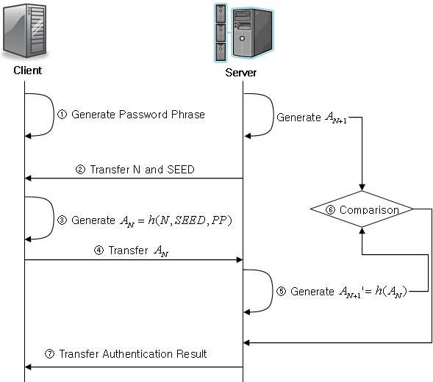
Notes:
① Client generates PP (Password-Phrase) that plays
secret key role while generating the password.
② Server transfers previous value N and SEED value
to client.
③ Client generates authentication request value AN
by using hash for N, SEED and PP.
④ Client transfers the generated authentication
request value AN
and request authentication.
⑤ Server executes has once more for the transferred
AN
and generates ' AN+1
.
⑥ Server executes authentication by comparing the
generated AN+1
and ' AN+1
that it holds.
⑦ Server transfers the authentication result to user.

Slide 6
S/Key Authentication Mechanism
Its limitations:
- safety depends on one-way function
- it uses password-phrase as secret key, it has the shortcoming
- It can be vulnerable to spoofing attack
Notes:
the limitation:
2- that it is vulnerable to dictionary attack,
and because it uses predictable N value and SEED

Slide 7
Challenge-Response based Authentication Mechanism
Should include mathematical function
At the same time the server should include numerical function
Notes:
This method is also called asynchronous one-time password mechanism. which one party presents a question ("challenge") and another party must provide a valid answer ("response") to be authenticated.
Also, it is the two-level scheme for authenticating network users that is used as part of the Web's Hypertext Transfer Protocol (HTTP).
For calculate the response value for challenge of both the client and the server.
To generate challenge

Slide 8
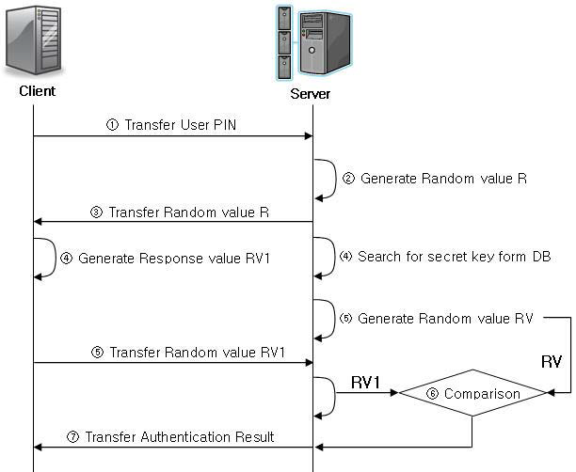
Notes:
① User transfers PIN.
② Server generates random value R.
③ Server transfers the random value R to user.
⑷ Server searches for the secret key for the PIN
from its database.
⑸ Server generates response value RV by encoding
random number R by using the secret key that
corresponds to the PIN.
④ User generates response value RV1 by encoding
random number R with its secret key.
⑤ User transfers the generated response value RV1
to server and requests authentication.
⑥ Server compares the response value received from
user and proceeds with authentication.
⑦ Server transfers the authentication result to user.

Slide 9
Challenge-Response based Authentication Mechanism
Its limitation:
The speed is very low .
Notes:
Since mathematical calculations are performed at each transfer time at both sides of client and server.

Slide 10
Authentication Mechanism using Time
This mechanism generates new random value at every fixed time interval( each 1 minute) period and processes authentication by generating one-time password

Slide 11
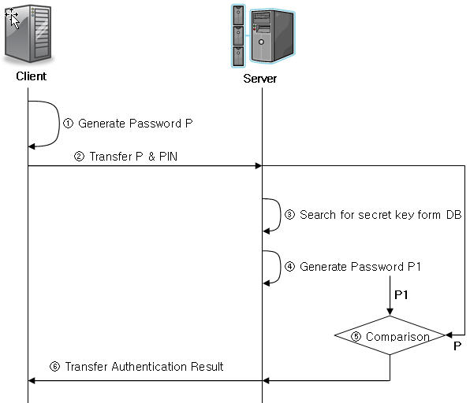
Notes:
① Client generates password P with the time
synchronized with server and secret key.
② Client requests authentication with its PIN and the
generated password.
③ Server searches for the secret key that corresponds
to the PIN of client in its database.
④ Server generates password P1 by using the time
synchronized with client and the secret key.
⑤ Server compares the password it generated and
the password received from user.
⑥ Server transfers the authentication result to user.

Slide 12
Authentication Mechanism using Time
Its limitations:
- It’s bound to face password re-using problem
- The time deviation
Notes:
*Because generates representative value for certain period or certain time and uses this value as input value for password. it has to solve time synchronization problem as well to use synchronized time between server and client.
* By Correction cycle among clients and servers and time deviation by client authentication data calculation time and transfer time delay.

Slide 13
The proposed System
It has four stages:
- certificate issuance and Registration
- User registration
- user authentication
- Password authentication
Notes:
One-time password mechanism solves password problems like password conjecture and wiretapping that can occur by using the same password several times repeatedly.
The proposed system, which adopts public key infrastructure as basic mechanism

Slide 14
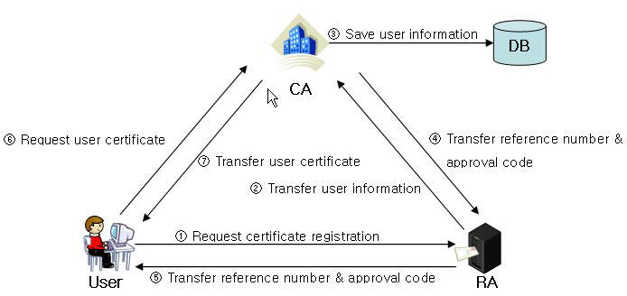
Certificate Issuance and Registration
Notes:
① User requests certificate registration by
submitting RA(Registration Authority) certificate
application and identity card duplicate copy.
② RA operator enters to CA the received user
information.
③ CA saves user identity information to database
Later on CA responds with the certificate status
that corresponds to the identity information about
the user verification request.
④ CA assigns RA operator with reference number
and approval code.
⑤ RA operator transfers to user the reference
number and approval code.
⑥ User checks the assigned reference number and
approval code assigned through
CMP(Certification Management Protocol) and
request CA the certificate
⑦ CA issues the certificate after checking the
reference number and approval code transferred
through CMP.

Slide 15
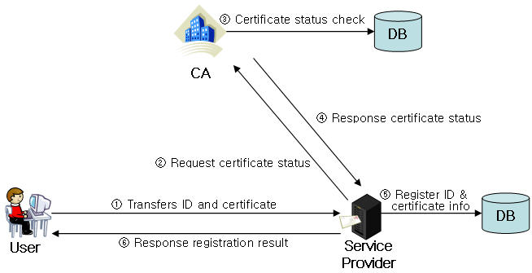
User Registration
Notes:
① User transfers the ID and certificate requested of
registration by accessing service provider, and
requests registration.
② Service provider transfers to CA the certificate
transferred from the user, and requests certificate
checking for the applicable user.
③ CA executes certificate checking for the user.
④CA transfers to service provider the certificate
checking result values for the applicable user.
⑥ In case of valid user, service provider registers in
its database the certificate information for the
user included in the ID and certificate. Certificate
information is later on used for user
authentication purpose.
⑦ Responses registration result to user.

Slide 16
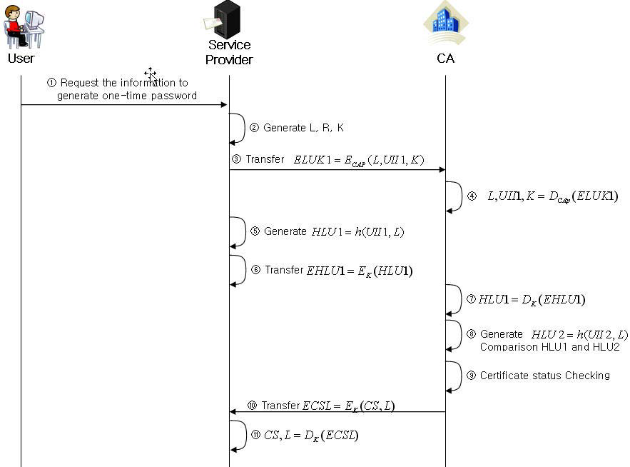
User Authentication
Notes:
① User transfers its own ID to service provider and
requests the information to generate one-time
password.
② Service provider generates label L, random value
R and symmetry key K. The generated label L is
used as the information to generate one-time
password for user while being used to identify the
communication between service provider and CA.
Random value R is used as the information to
generate one-time password and symmetry key K
is used to encode the message at the time of user
authentication request and response with CA.
③ Service provider transfers label L, user identity
information UII1 and symmetry key K through
electronic envelop ELUK1 by encoding them
with CA public key.
④ CA obtains label L, user identity information UII1
and symmetry key K by deciphering the
transferred electronic envelop ELUK1 with its
own private key.
⑤ Service provider generates the result value HLU1
that applied hash function for the user identity
information UII1 and communication identity
label L that apply the user ID.
⑥ Service provider generates the value EHLU1
which resulted by encoding the generated hash
value HLU1 with symmetry key K and transfer it
to CA.
⑦ CA deciphers EHLU1 by using symmetry key K,
and obtains the hash value HLU1.
⑧ User generates HLU2 by obtaining from database the user identity information UII2 that has been in possession in certificate registration process and applying hash function for UII2 and label L, and verifies for integrity by comparing HLU1 and HLU2.
⑨ CA verifies the status of user certificate for UII1 after verifying for integrity.
⑩ CA transfers to service provider ECSL, which is the value obtained by encoding certificate status CS and communication identifier label L with symmetry key K.
⑪ Service provider deciphers ECSL by using symmetry key K and obtains certificate status CS and label L.
⑫ Service provider authenticates the user by checking user certificate status CS.

Slide 17
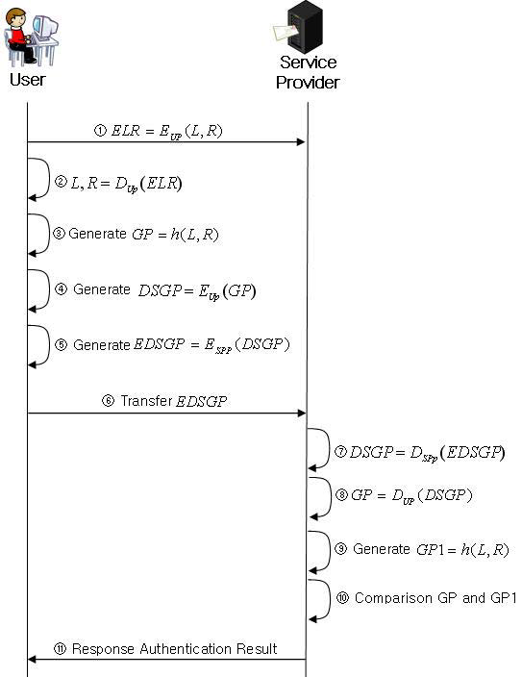
Password Authentication
Notes:
① Service provider transfers to user the value ELR obtained by encoding communication identifier label L and random value R by using user public key.
② User obtains label L and random value R by using its own private key and generates password GP by using hash function.
③ User digital signature the generated password its own private key and transfers the value EDSGP obtained by encoding this signed value with service provider’s public key. At this time, denial prevention is secured through digital signature using user’s private key, and birthday attack can be prevented to restore original text by finding the
same value due to indiscriminate attack for has value.
④ Service provider performs deciphering for the authentication request value transferred from user by using its own private key, and obtains the password GP by using user public key.
⑤ Service provider generates the password GP1 by applying hash function for label L and randomized number R.
⑥ Service provider finally authenticates the user password if no abnormality is found by comparing the password GP1 it generated and the password GP received from user

Slide 18
Comparison and Analysis
Adaptability for Spoofing Attack
Adaptability for Replay Attack
Time Synchronization
Confidentiality
Integrity
Non- repudiation
Notes:
*Adaptability for Spoofing Attack: Since S/key authentication mechanism uses easily predictable N value and SEED value, the Attacker can easily guess and can request authentication to service through this. So, The system proposed authenticates user through certificate, and since the password for the applicable session is encoded once again with the public key of service provider while the password for the applicable session is electronically signed by using the private key only the user itself knows, So spoofing attack can be prevented beforehand.
* Adaptability for Replay Attack: In the proposed system can prevent replay attack, since password is generated through label L and random value R used as session identifier to the applicable session.
*Time Synchronization: In the proposed system doesn’t require time synchronization because it uses label L and random value R as input value.
*Confidentiality : In S/key provides integrity but not confidentiality. Challenge-Response Mechanism and time using mechanism provide confidentiality by using symmetry key algorithm. But The system proposed provides both by using public key algorithm.
* Integrity
* non-repudiation: The proposed system provides non- repudiation function which is not provided in other methods. Because the proposed system transfers authentication information after electronically signing with the use of user’s private key.

Slide 19
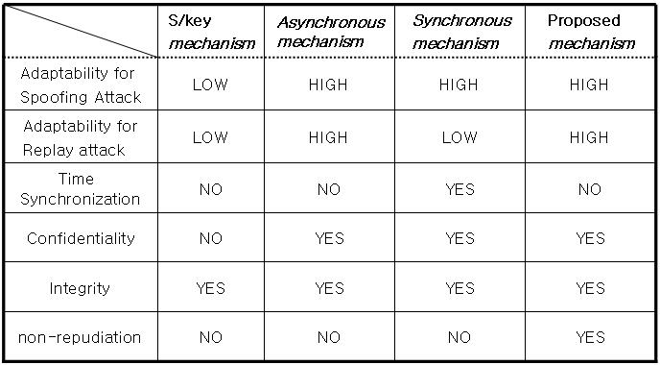

Slide 20
Conclusion
This paper analyzed the problem of vulnerability of authentication mechanism security by using the existing methods and proposed one-time password mechanism using public key infrastructure.
Notes:
The proposed mechanism can prevent spoofing attack in advance by authenticating user with the use of certificate
information, and solves the problems of replay attack, time synchronization and integrity by generating password by applying hash function for label L and random value R which are used only in applicable session. Also, transfer of the generated password by electronically signing with user’s private key and encoding it with service provider’s public key guarantees non-repudiation and prevents birthday attack. However, it has a shortcoming that authentication takes some more time because it focuses in security rather than time such as internet banking, electronic payment, medical system and e-commerce

Slide 21
Question?

